Slide 1


The Gotham Paradox: Decoding Happiness in the City of Shadows
INTRODUCTION
Yiting Tan
Sergio Grisales
Shamayita Choudhury
Girish Pandit

Slide 2


Prologue – Gotham City A metropolis of skyscrapers and neon lights
Despite the efforts of the mayor of Gotham to invest in schools, infrastructure, social community events and security, happiness is declining.
THE MISSION:
Identify the key factors and the best model that contribute to the happiness of all residents and collaborate with council members and residents before the upcoming election.

Slide 3

Agenda
Exploratory Data Analysis (EDA)
By Shamayita
Model Overview and Analysis
By Eva
Conclusion & Recommendations
By Girish

Slide 4
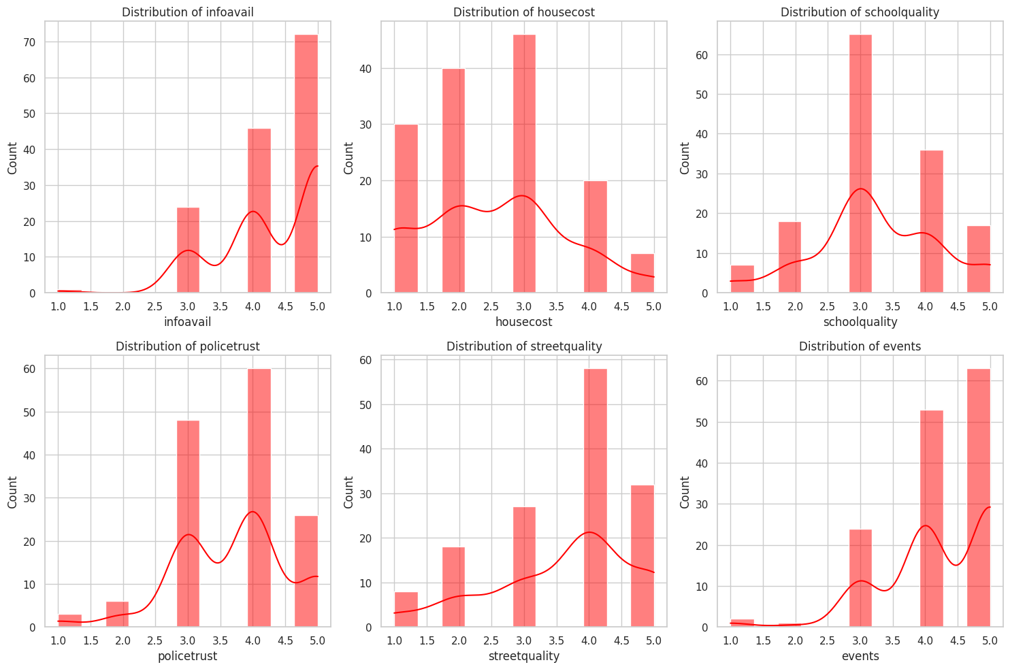
Citizen Dataset
MISSION:
TO MAKE OUR CITIZENS HAPPY
PROCESS:
Exploratory survey of 143 citizens representative of the population
ASPECTS:
Availability of information about city services
Cost of housing
Quality of public schools
Trust in the local police
Maintenance of streets and sidewalks
Availability of social community events
Decision attribute: Happy (1) and Unhappy (0)
HAPPINESS QUOTIENT:
54% HAPPY

Slide 5
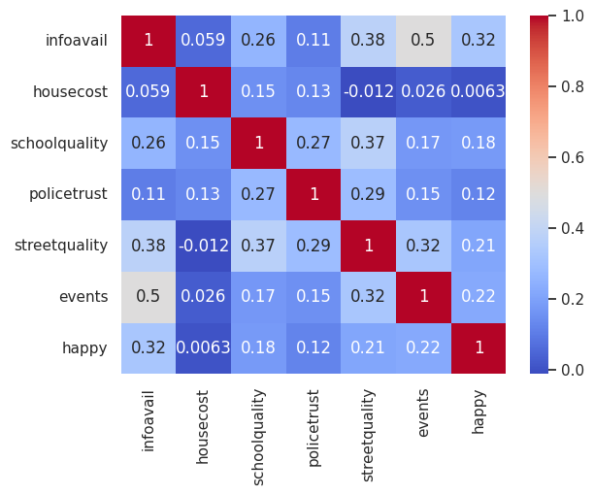
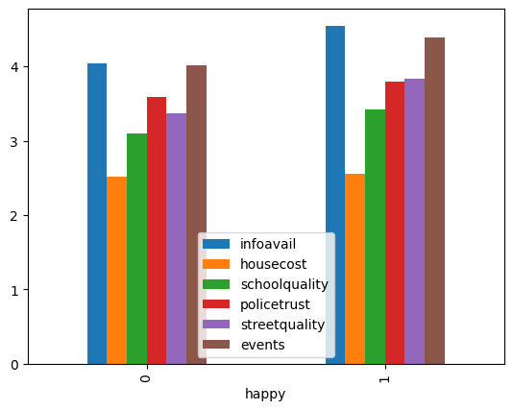
Exploratory Data Analysis
SPEARMAN CORRELATION MAP:
TO IDENTIFY FEATURES CORRELATED TO HAPPINESS
PRELIMINARY INSIGHTS:
3 features that have hughes correlation are:
Information Available
Events
Street Quality
Information availability and events were highest rated for happy and unhappy people
Police Trust was high and similar for both groups
Street quality was rated higher by happier people compared to unhappy people
House Cost and School quality rate the lowest for both groups
MEAN VALUE OF FEATURES:
TO OBSERVE THE AVERAGE VALUE OF FEATURES FOR HAPPY AND UNHAPPY CITIZENS
FURTHER ANALYSIS:
Data will be evaluated further using different classification models to identify factors to improve happiness quotient for our citizens

Slide 6
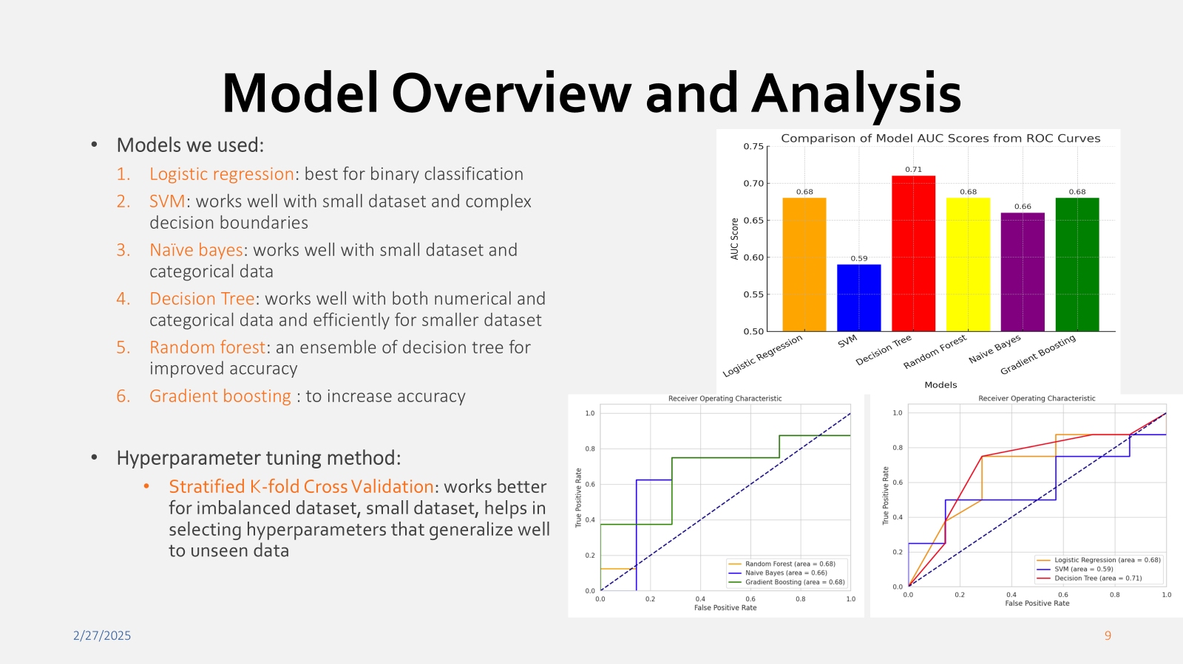

Slide 7
